Slide 1
Blind Navigation System
  Overview
  Obstacle detection.
  Real time text reading (OCR).
  Face detection and virtual tagging.
  Writing pad.

Slide 2
Introduction
A system which simplifies daily lifestyle of blind by providing the mechanism to detect and avoid obstacles.
The system is capable of reading real time texts and converts it to audio output.
The system also includes Braille Pad (B-Tab) to type text with a facility for storing contacts, notes and mobile like functionality songs, date and time.
It also has face detection and recognition facility.

Slide 3
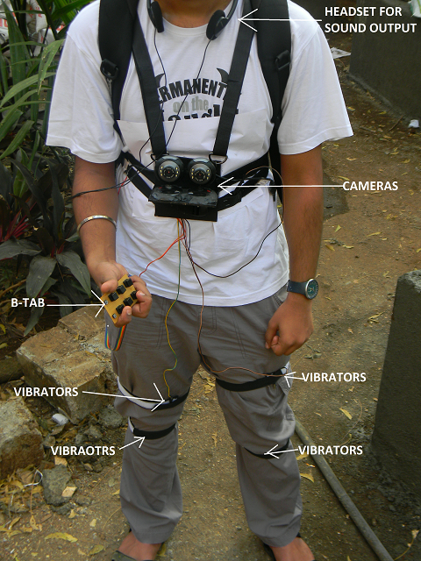
Hardware Requirements
  For Prototype
  Two webcams (4 MP)
  Micro-controller (Atmega 16)
  Writing pad
  Laptop (computing)
  Vibrators on body (6 in all)

Slide 4
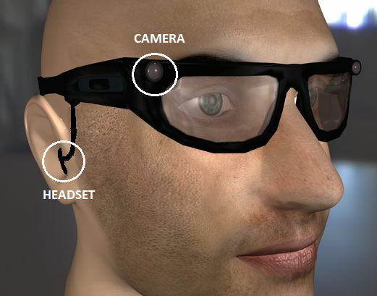
Hardware Requirements
  For Final Draft
  Specs with embeded
  cameras & headset.
  Mobile device for computing
  & as a mobile hardware.
  Vibrators.

Slide 5
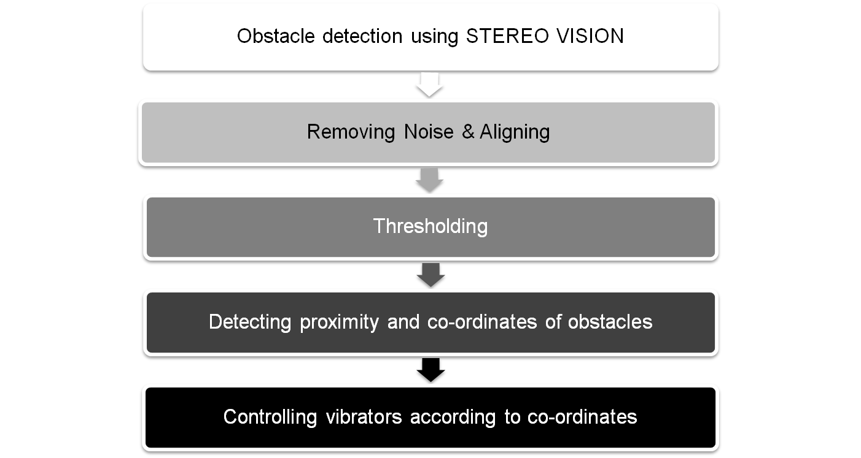
Obstacle Detection

Slide 6
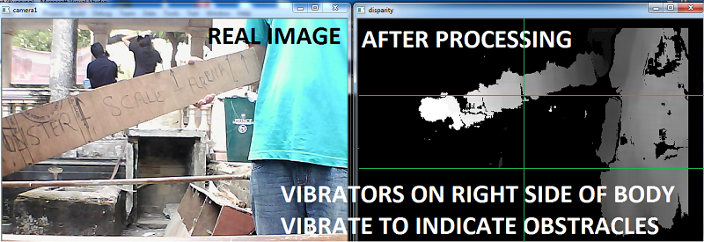
Obstacle Detection

Slide 7
Obstacle Detection
Accuracy – 60 - 80%
Time taken – 200 ms approx
Uses – 1) Detecting obstracles.
    2) Finding odd terrains.
    3) Pith detection.
Challenges – Low FPS at night

Slide 8
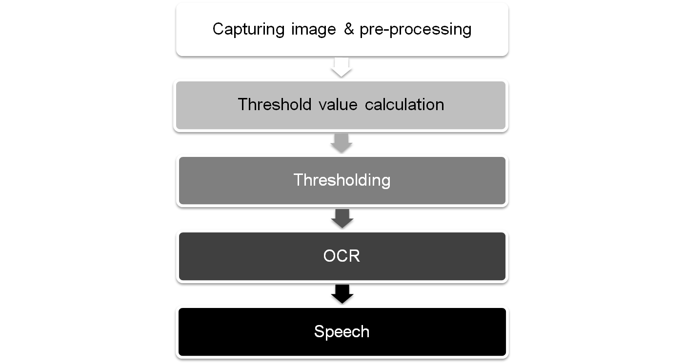
Real time text reading

Slide 9
Real time text reading
Accuracy – 80 - 90%
Time taken – 1000 ms approx
Uses – 1) Reading books, newspapers.
    2) Reading notice boards.
Challenges – Lot of pre-processing involved, Indian languages.

Slide 10
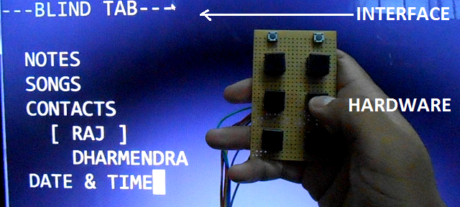
Writing Pad (Braille pad)
System which simplifies daily
mobile usage for blind people.
Based on sound output.
Also includes facility to type
text in Braille Language.
System currently includes Notes, Songs, Contacts, Date & Time options.

Slide 11
Writing Pad (Braille pad)
Time taken – 700 - 1000 ms approx
Uses – 1) Mobile device.
    2) Remote to switch between various operations.
Challenges – GSM facility.

Slide 12
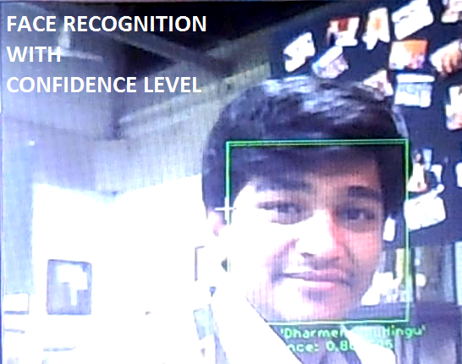
Face Detection
A system which can identify
a person in front of camera
using trained data.
The system is based on
sound output.
Includes on time new
database creation & training.
Scale invarient.

Slide 13
Face Detection
Time taken – 200 ms approx
Uses – 1) Face detection.
    2) Emotion detection.
    3) Confidence in communication.
Challenges – Better Emotion detection.

Slide 14
Costing (Approx)
2 Cameras – 1000rs.
Processor – 1500 - 2000rs
Vibrators & circuitry – 100rs
Software – free
Total – 3000 - 4000rs

Slide 15
Blind Navigation System
  Project by
  Raj Samant
  Dharmendra Hingu
  Saurabh Nair
  Sarvesh Hegde

